Slide 1
Team Caps
Comprehensive Assessment and Preparation System

Slide 2

Students currently face challenges in accessing personalized, effective assessment tools that help them identify and improve their weaknesses. Our Comprehensive Assessment & Preparation System aims to fill this gap by offering tailored assessments, adaptive learning tools, and detailed performance analytics in a user-friendly, secure web-based platform.

Slide 3

Project Scope:
The CAP System is limited to JRMSU students in different campuses who are willing to partake and improve their knowledge on specific engineering subject offered in our system. Furthermore, the actual(not for practice) questions that was stored in the databank may be used in examination and Qualifying Exams.

Slide 4
Statement of the Problem:
1. What is the Authentication (Log in phase problem) process?
2. How can the hierarchy of the faculty affect the Questions in terms of
a) Adding,
b.) Modifying,
c.) Removing Question
3. In what way we can Classify Questions (Subject, Difficulty level, and Coverage) ?
4. How can Approval Process Implemented?
5. How to implement Tagging (Too Easy and Too difficult Question)?
6. How can Student partake on the test problem and monitor their progress.

Slide 5
the Functional & Non-Functional RequirementS

Slide 6
Functional:
1. Registration & Login:
Allow users to register, and log in
2. Authentication & Authorization:
Implement secure user authentication and role-based access control (students, instructors, administrators).
3. Test Creation & Administration:
Enable instructors to create, modify, remove, and publish assessments(For faculty, program chair and higher).
4. Question Bank:
Maintain a repository of random questions organized by subject, coverage, and difficulty.
5. User and Content Management:
Enable administrators to manage users, monitor system usage, and moderate content.
6. Time Management (Optional):
Include features like timers, auto-save, and test resumption options.

Slide 7
Non-Functional:
1. User Load:
Design to support growth, with an initial target of 1000-5000 concurrent users and a roadmap for scaling beyond this range.
2. Modular Monolithic Design:
Use a modular monolithic architecture to allow independent scaling of components
3. Uptime:
Aim for 99.8% system availability.
4. Error Handling:
Implement robust error detection, logging, and recovery mechanisms to minimize downtime.
5. Backup & Recovery:
Regularly backup data and ensure quick recovery in case of system failures.
6. Data Protection:
Encrypt sensitive data both in transit and at rest.
7. User Interface:
Design a clean, intuitive interface that is accessible to users with varying levels of technical proficiency.
8. Accessibility:
Comply with accessibility standards to ensure the system is usable by all students.

Slide 8
Oversee and manage the project backlog (tasks must be structured and prioritized).
Structured Backlog Organization:
Epics & User Stories:
Break down the project into high-level epics (major features or modules) and further decompose these into user stories and tasks.
Task Definition:
Each task will include a clear description, acceptance criteria, estimated effort, and relevant dependencies.

Slide 9
Oversee and manage the project backlog (tasks must be structured and prioritized).
Prioritization:
Value vs. Effort Analysis:
Assess tasks based on their value, effort and implementation complexity, ensuring a balanced workload.
Stakeholder Input:
Regularly engage with the sponsor and stakeholders to re-assess priorities and align with evolving project goals.

Slide 10


Oversee and manage the project backlog (tasks must be structured and prioritized).
Project Management Tools:
Trello:
it provides a flexible and visual way to manage tasks, track progress, and collaborate with team members. Since CAPS follows a modular monolithic design and uses a structured backlog, Trello can help streamline the development and management process by organizing tasks and improving communication among the team.
GitHub:
Use as project management tool to manage the backlog, allowing for easy tracking, updating, and visualization of task status.

Slide 11
Regular Backlog Grooming:
Scheduled Review Meetings:
Maintain daily, weekly or bi-weekly backlog grooming sessions to refine, re-prioritize, and estimate tasks.
Sprint Planning:
At the start of each sprint, select and commit to high-priority tasks, ensuring alignment with project milestones.

Slide 12
User stories
User Story #1: Super Admin: As the super admin I have the overall access of the system.
User Story #2: Admin/ College Dean/Associate Dean: As the Admin/Dean/Associate Dean, I have most of access to the website. I have the power to assign and reassign faculty members, remove tagged questions, give approval, add modify and remove questions, select subject difficulty and print questions for qualifying exam, select subject difficulty and print questions for school and examination use.
User Story #3: Program Chair: As the Program Chair, I am responsible for removing tagged questions, give approval, add, modify and remove questions. Select subject, coverage, and difficulty and print questions for school and examination uses.
User Story #4: Faculty/Staff: As a Faculty/Staff, I have the power to add, modify, and remove questions but can’t update unless approved by the Program Chair or the College Dean. I can select subject, its difficulty and coverage to print for school and examination purposes.
User Story #5: Students: As a student, I can select subject, and coverage for practice problems and answer it, it depends on me if I set a timer for the practice.

Slide 13
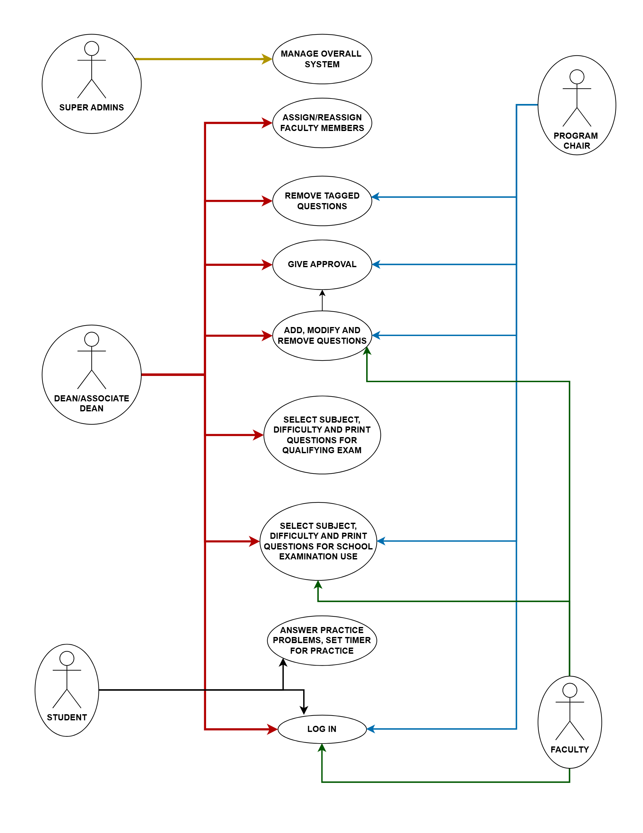
User case

Slide 14
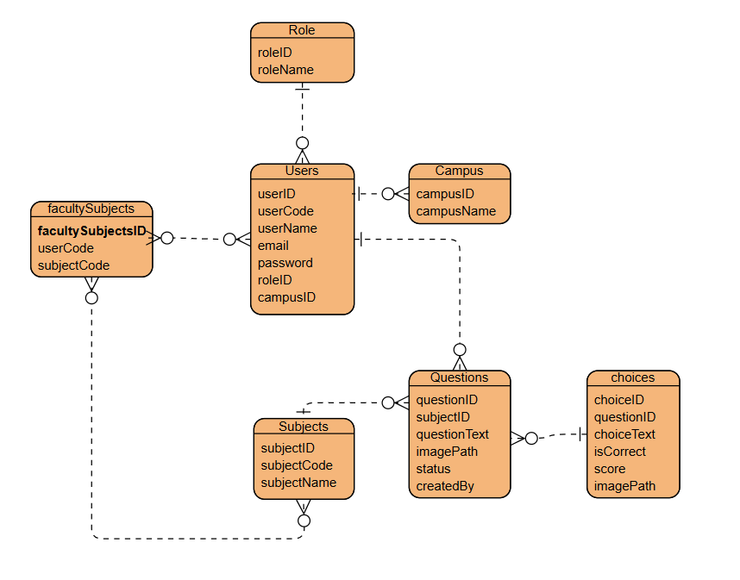
Entity relationship diagram (erd)

Slide 15
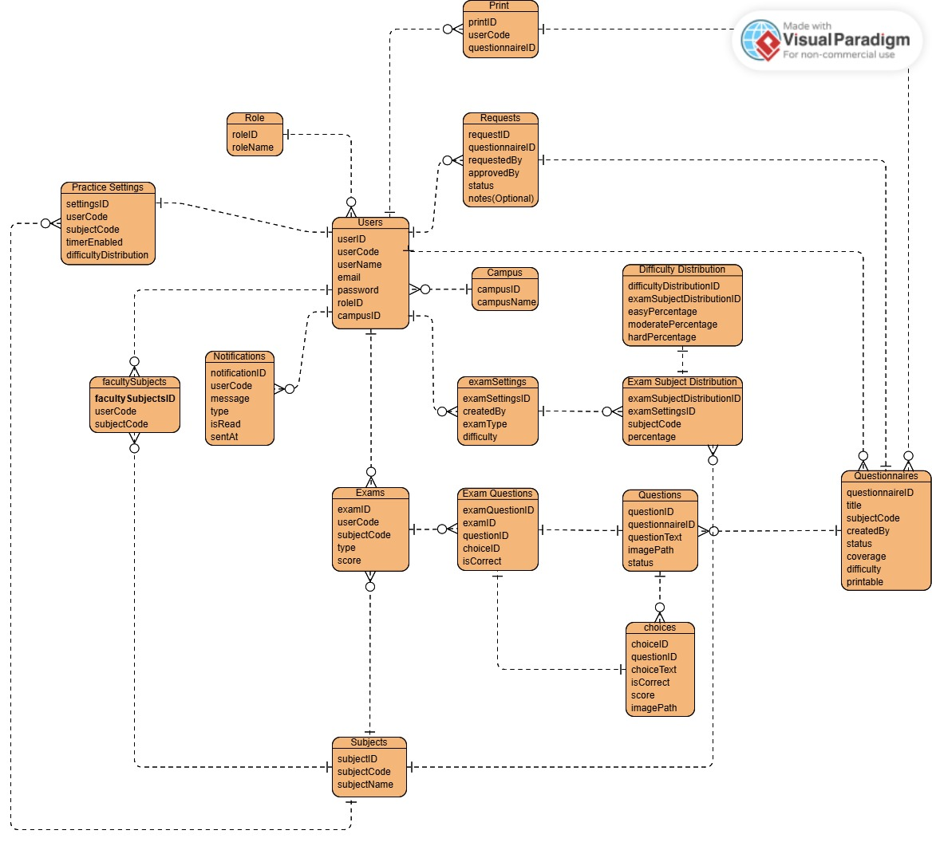
Entity relationship diagram (erd)

Slide 16
CAP SYSTEM MVP

Slide 17
USER AUTHENTICATION
➢ Secure login for students, faculty, program chairs, and super admins.
User can Register and ensure their sensitive data is encrypted
User can Log-In using their credentials that they’ve registered
User can Change Password.
➢ Role-Based Access Control (RBAC) – Users have different permissions.
Each User has different functionality.
It uses Inheritance Process.
User can access different functionality depending on their role on the hierarchy.

Slide 18
QUESTION BANK MANAGEMENT
➢ Faculty can add, modify, remove but changes require approval from Program Chair/Dean.
All faculty members has the ability to add, modify, and remove question.
Any Changes from faculty in the question bank needed an approval from Program Chair and higher.
➢ Categorization of questions.
In Category, there’s Subject, Difficulty, and Coverage.
Faculty can select category on where they want to store the questions.

Slide 19
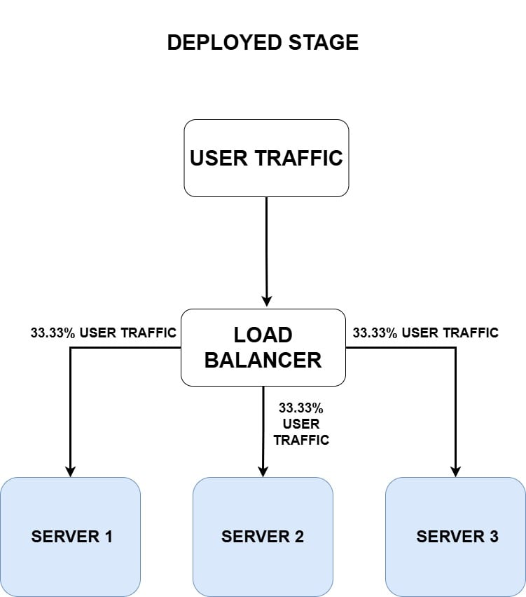
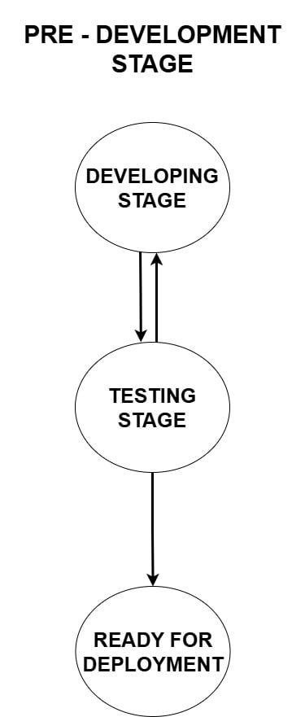
Deployment strategy

Slide 20
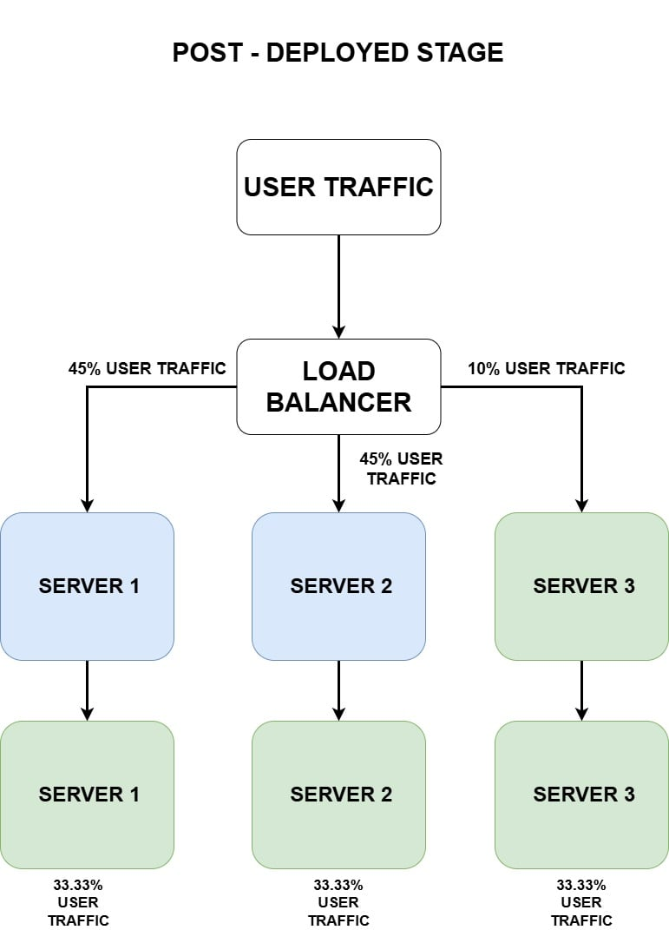
Deployment strategy

Slide 21
Thank you
Team CAPS
Darj
Carlos
Tan
Kent

